Slide 1
SOLID DESIGN PRINCIPLES
BANDI ABHILASH

Slide 2
Agenda
What exactly design is
Identifying a bad design
SOLID Principles

Slide 3
What is design
What is the meaning of design
In other terms, what is the difference when compared to analysis
Analysis is about what
Design is about how

Slide 4
Why do we need a good design?
Maintainability
To deal with complexity
To deliver fast
Extensibility

Slide 5
How do we know a design is bad?
What is the criteria for a bad design
What are the “Symptoms” of a bad design
Fragility
Rigidity
Immobility
Viscosity

Slide 6
Rigidity
The impact of a change is unpredictable
Every change causes a cascade of changes in dependent modules
A few days “sprint” becomes a endless marathon
Costs become unpredictable

Slide 7
Fragility
The software tends to break/misbehave in many places on every change
The breakage occurs in areas where there is no conceptual relationship
On every fix the software breaks in unpredictable ways

Slide 8
Immobility
Its almost impossible to reuse interesting parts of the system
The useful modules have too many dependencies
The cost of rewriting is less compared to risk faced to separate those dependent parts.

Slide 9
Viscosity
A hack is cheaper to implement than the solution within the design
It’s much easier to do the wrong thing than the right thing
A development environment where “check-ins”, “check-outs”, “merges” are taking a long time
Testing and building takes long times
Tightly coupled modules.

Slide 10
Design
What’s the reason why a design becomes rigid, fragile, immobile and viscous.
Simply why a code rots/smells?
Improper dependencies between modules

Slide 11
Lets see a Code Rot

Slide 12
Design
What are the characteristics of a good design?
High Cohesion
Low Coupling

Slide 13
Good Design
How can we achieve a good design?
…………… applying SOLID principles
SRP
OCP
LSP
ISP
DIP

Slide 14

SOLID Principles
Was termed by “Robert Cecil martin” (Uncle Bob)
Co-author of the Agile Manifesto.
Its an Acronym for Acronym’s
SRP :- Single Responsibility Principle OCP :- Open Closed Principle LSP :- Liskov Substitution Principle ISP :- Interface segregation principle DIP :- Dependency inversion principle
It is part of an overall strategy of agile and adaptive programming.

Slide 15
Single Responsibility Principle
A class should have only a single responsibility (i.e. only one potential change in the software's specification should be able to affect the specification of the class)
Martin defines a responsibility as a reason to change, and concludes that a class or module should have one, and only one, reason to change.
The responsibility is defined as a charge assigned to a unique actor to signify its accountabilities concerning a unique business task.

Slide 16
Open Closed Principle
The open/closed principle states "software entities (classes, modules, functions, etc.) should be open for extension, but closed for modification“.
Bug fixing is not counted as modification.
Bertrand Meyer is generally credited for having originated the term open/closed principle
Composition over Inheritance.

Slide 17
Liskov Substitution Principle
If S is a subtype of T, then objects of type T may be replaced with objects of type S (i.e., objects of type S may substitute objects of type T) without altering any of the desirable properties of that program (correctness, task performed, etc.)
Objects in a program should be replaceable with instances of their subtypes without altering the correctness of that program.

Slide 18
Interface segregation principle
The interface-segregation principle (ISP) states that no client should be forced to depend on methods it does not use.
ISP splits interfaces which are very large into smaller and more specific ones so that clients will only have to know about the methods that are of interest to them. Such shrunken interfaces are also called role interfaces.

Slide 19
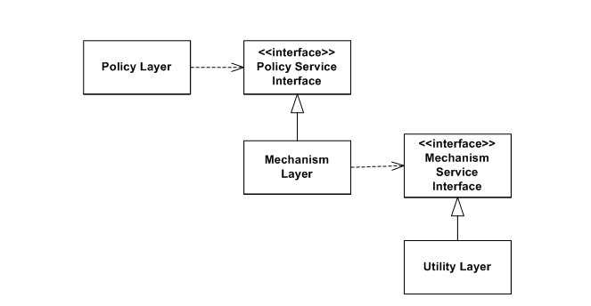
Dependency inversion principle
What it states
High-level modules should not depend on low-level modules. Both should depend on abstractions.
Abstractions should not depend on details. Details should depend on abstractions.

Slide 20
Conclusion

